Slide 1

CREDIT CARD APPROVAL
Cloud Computing
&
Big Data

Slide 2
TABLE OF CONTENTS
01
02
03
CLOUD SETUP
DATA INGESTION
DATA MANIPULATION USING DATABASES

Slide 3
TABLE OF CONTENTS
04
05
06
DATA ENRICHMENT
DATA VISUALIZATION
DATA ANALYSIS USING SPARK NOTEBOOKS

Slide 4
CLOUD SETUP

Slide 5
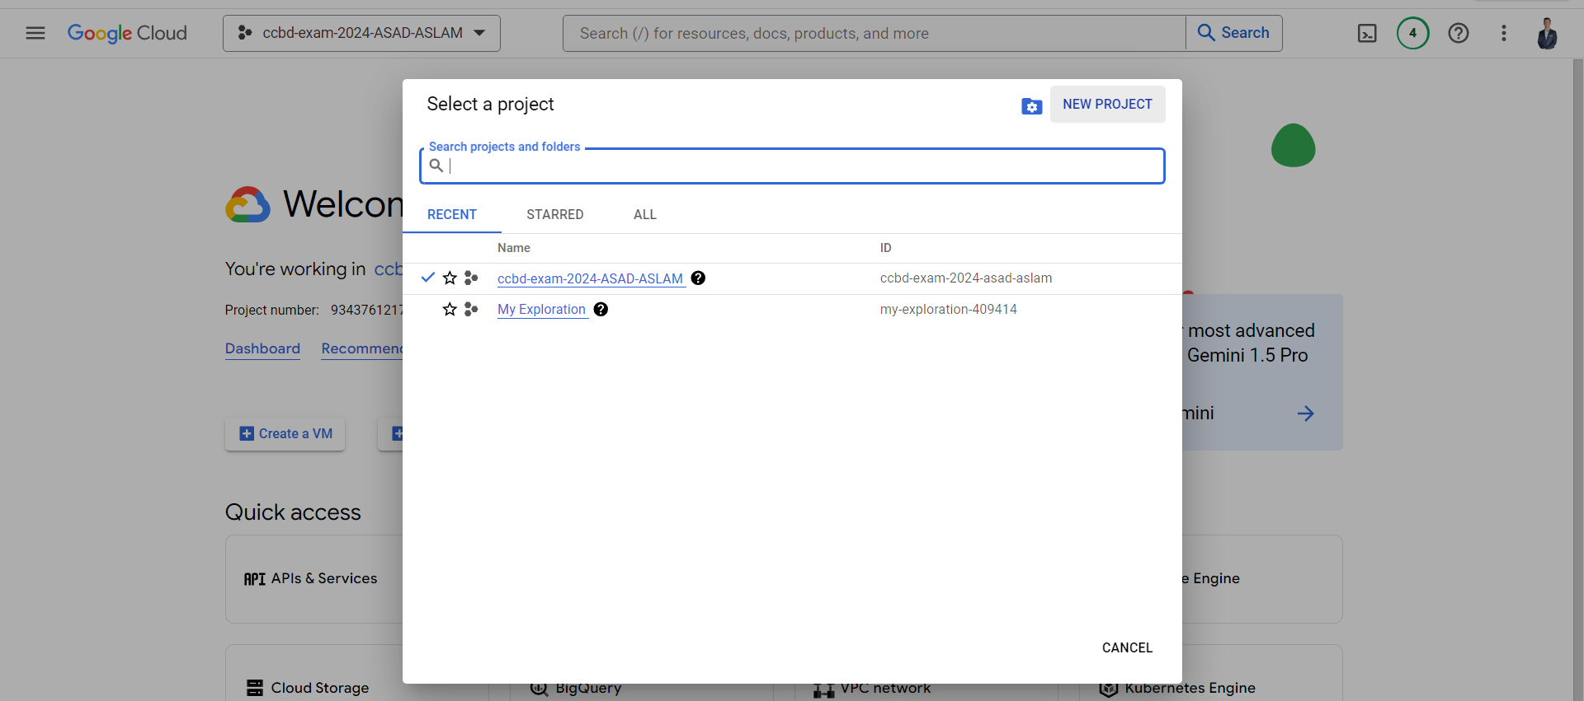
CREATE A GOOGLE CLOUD PROJECT

Slide 6
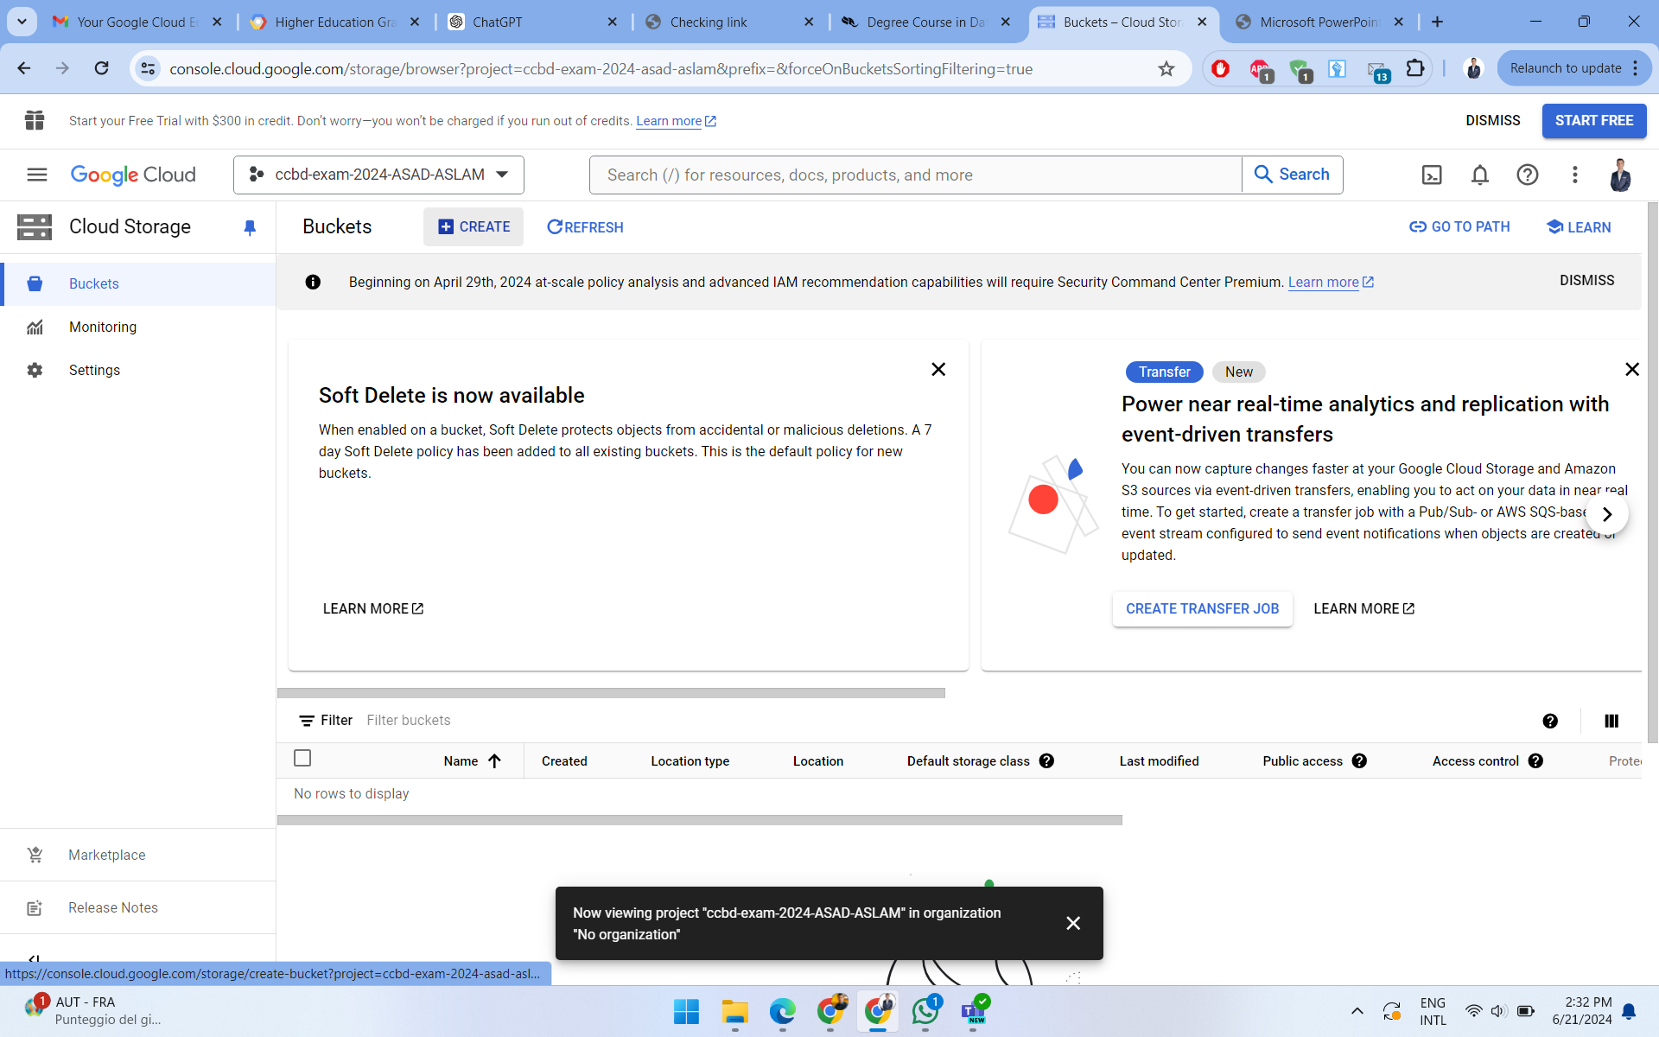
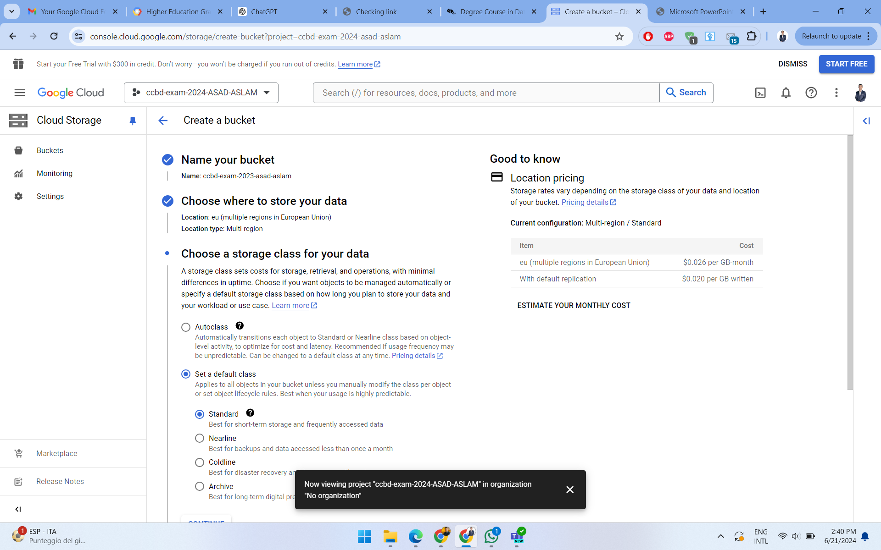
CREATE A GOOGLE CLOUD BUCKET

Slide 7
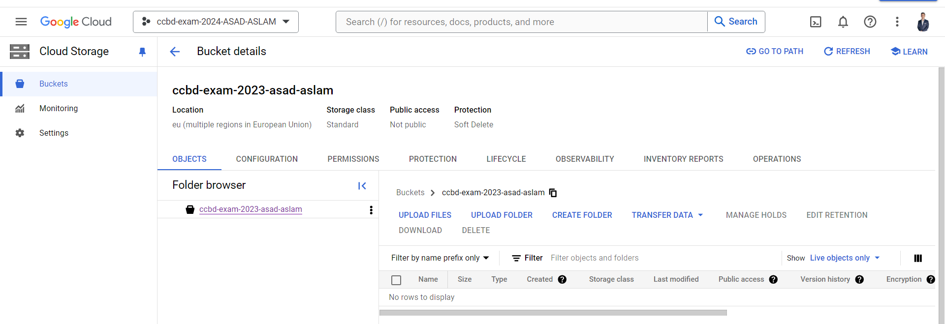
CREATE A GOOGLE CLOUD BUCKET

Slide 8
DATA INGESTION

Slide 9
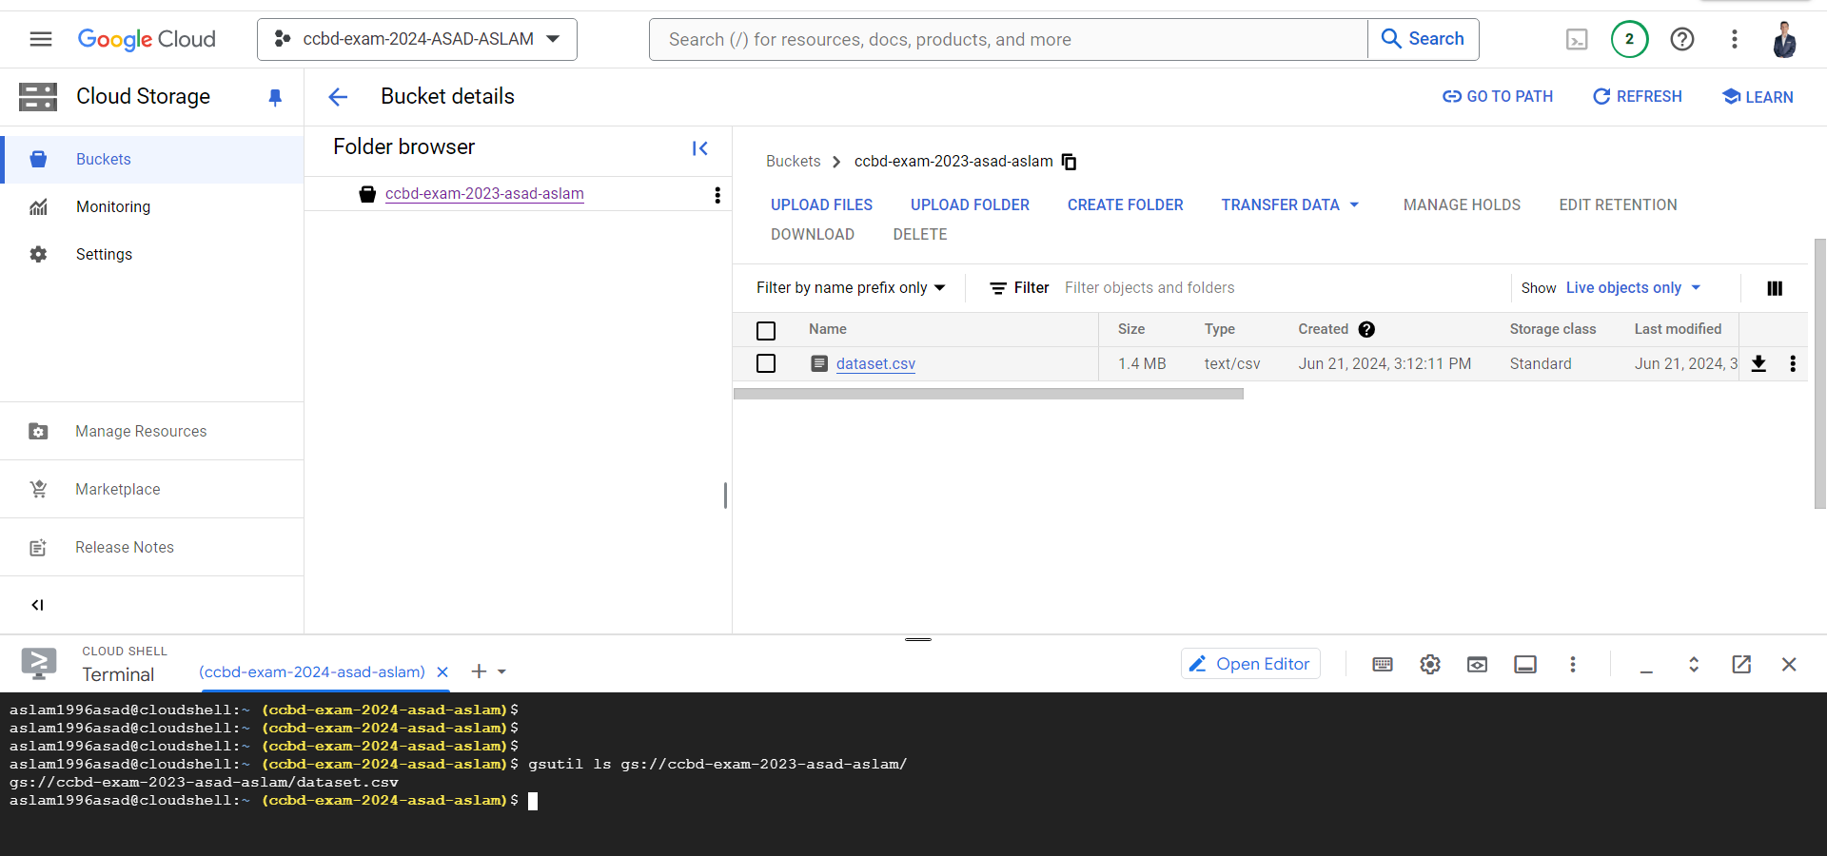
UPLOAD DATASET TO GOOGLE CLOUD

Slide 10
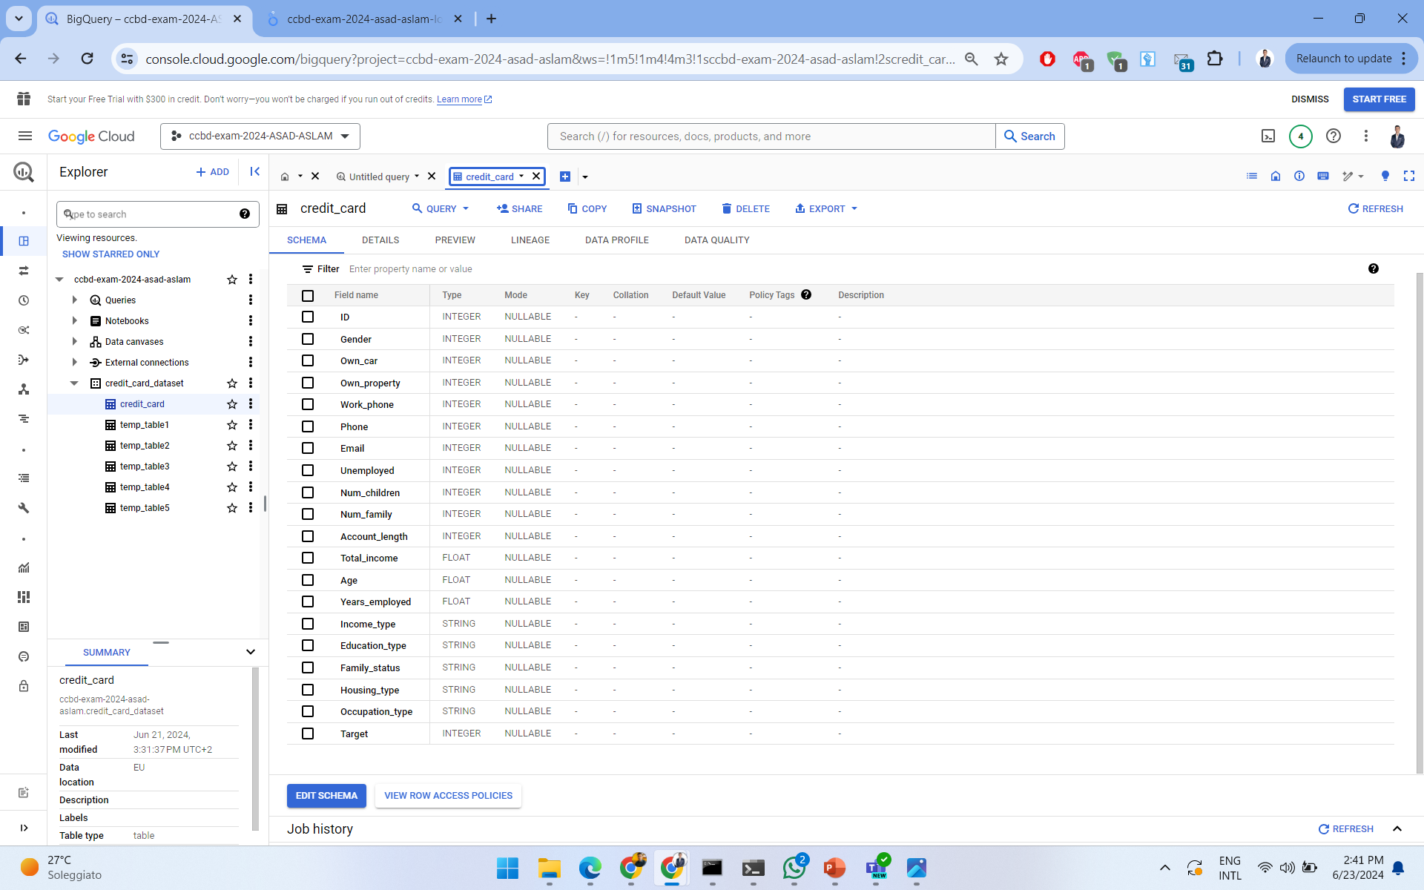
DATASET

Slide 11
DATA MANIPULATION USING DATABASES

Slide 12
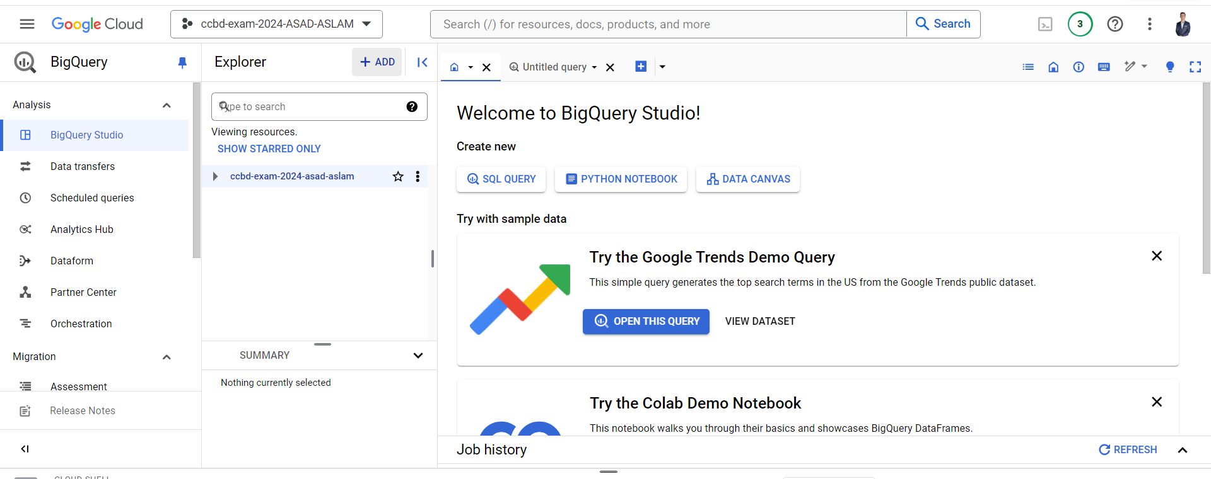
UPLOADING DATASET TO BIG QUERY 1/6

Slide 13
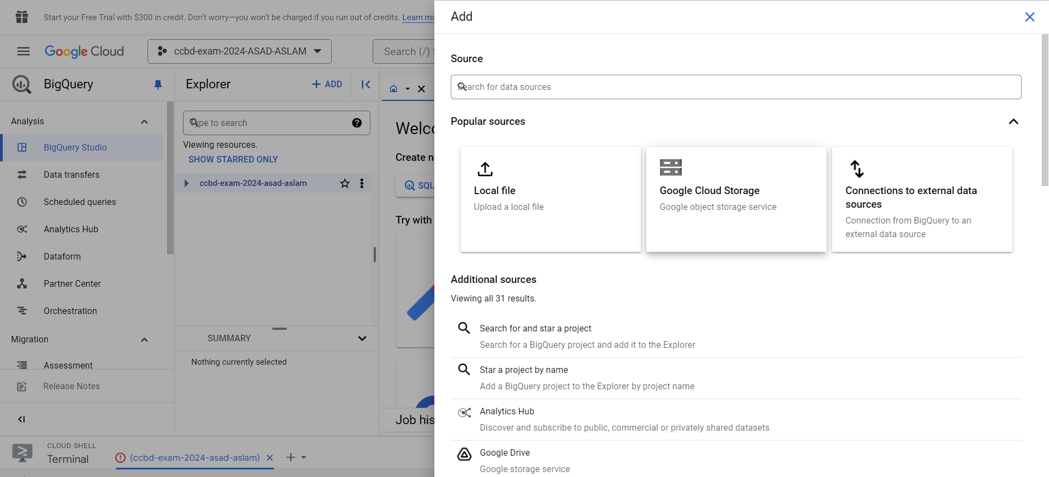
UPLOADING DATASET TO BIG QUERY 2/6

Slide 14
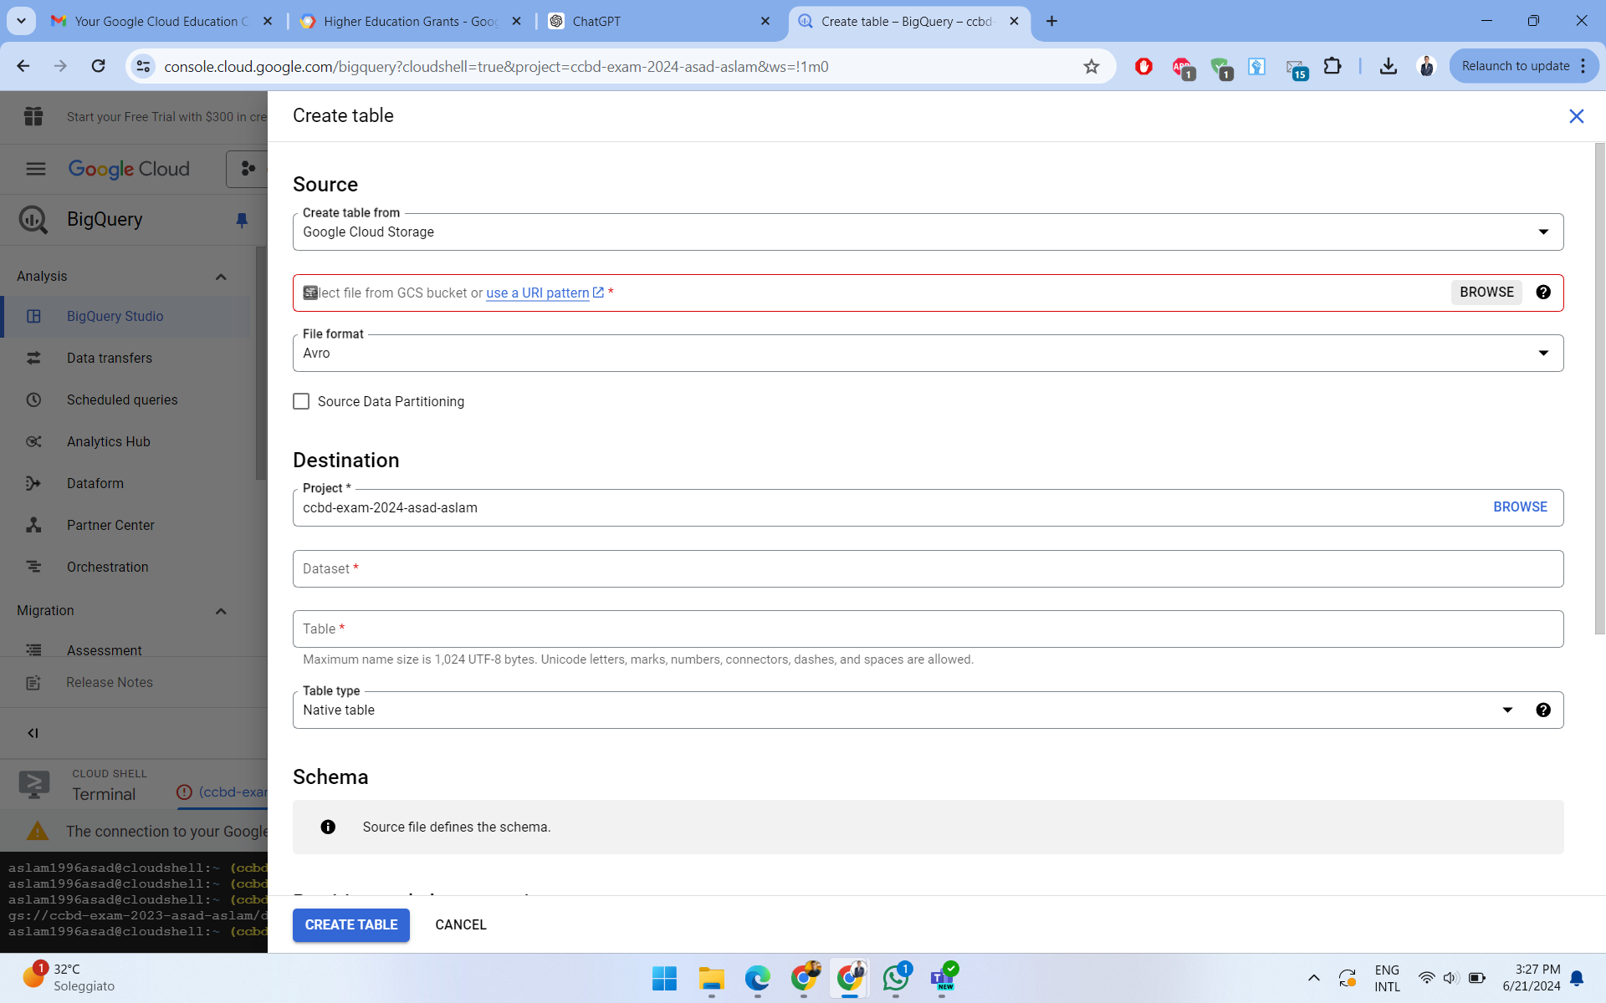
UPLOADING DATASET TO BIG QUERY 3/6

Slide 15
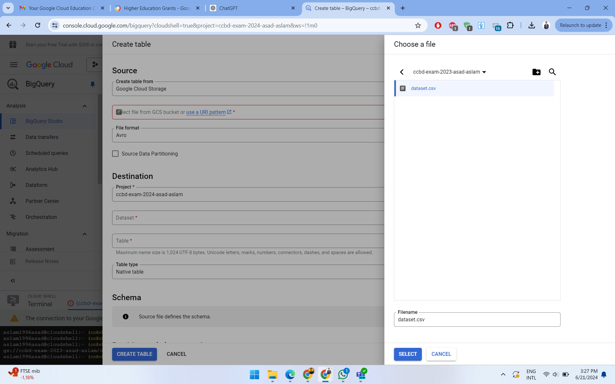
UPLOADING DATASET TO BIG QUERY 4/6

Slide 16
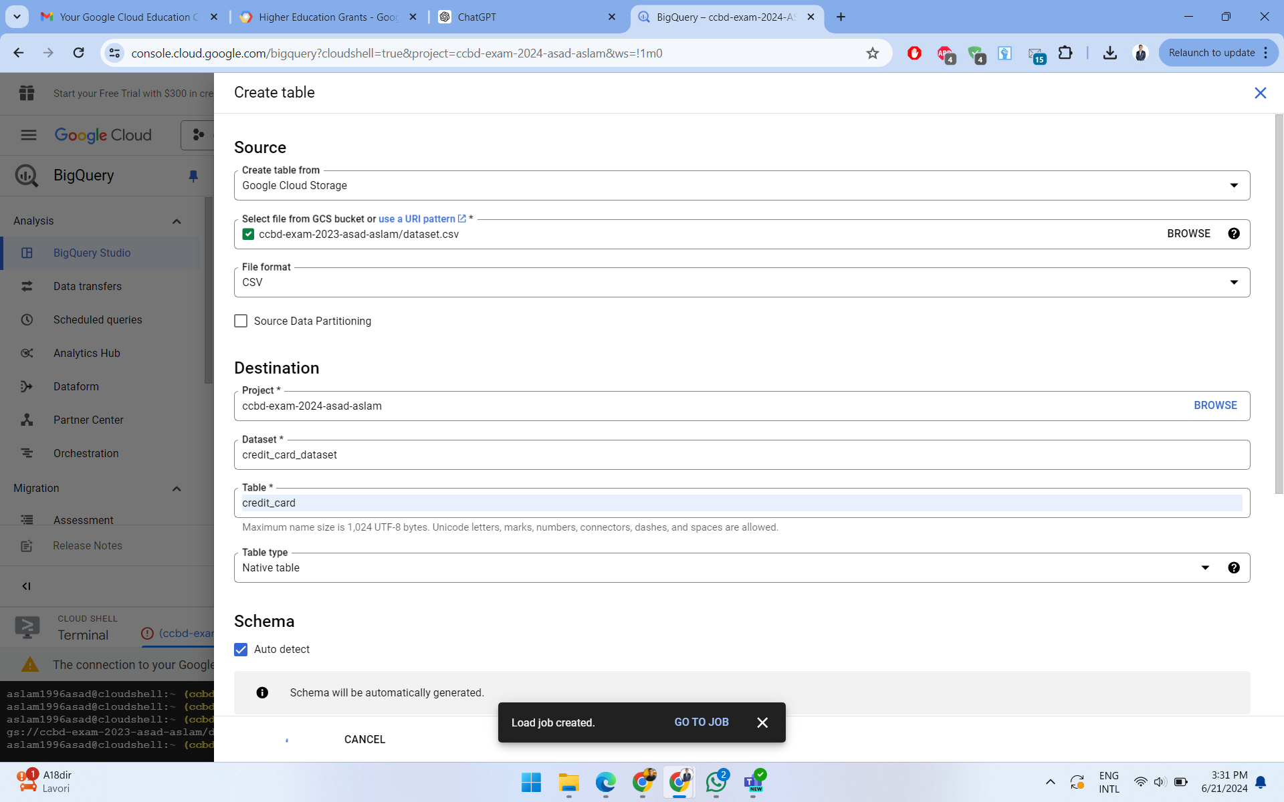
UPLOADING DATASET TO BIG QUERY 5/6

Slide 17
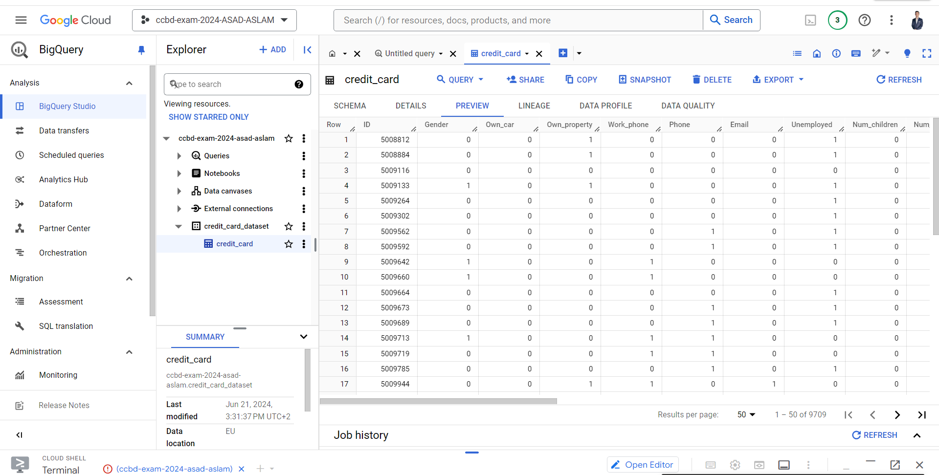
UPLOADING DATASET TO BIG QUERY 6/6

Slide 18
QUESTIONS
What is the average Total_income for each Occupation_type?
How many people own a car and have an income greater than $50,000?
What is the distribution of Education_type among people who are unemployed?
What is the average number of Num_family members for different Housing_type categories?
What is the correlation between Years_employed and Total_income?

Slide 19
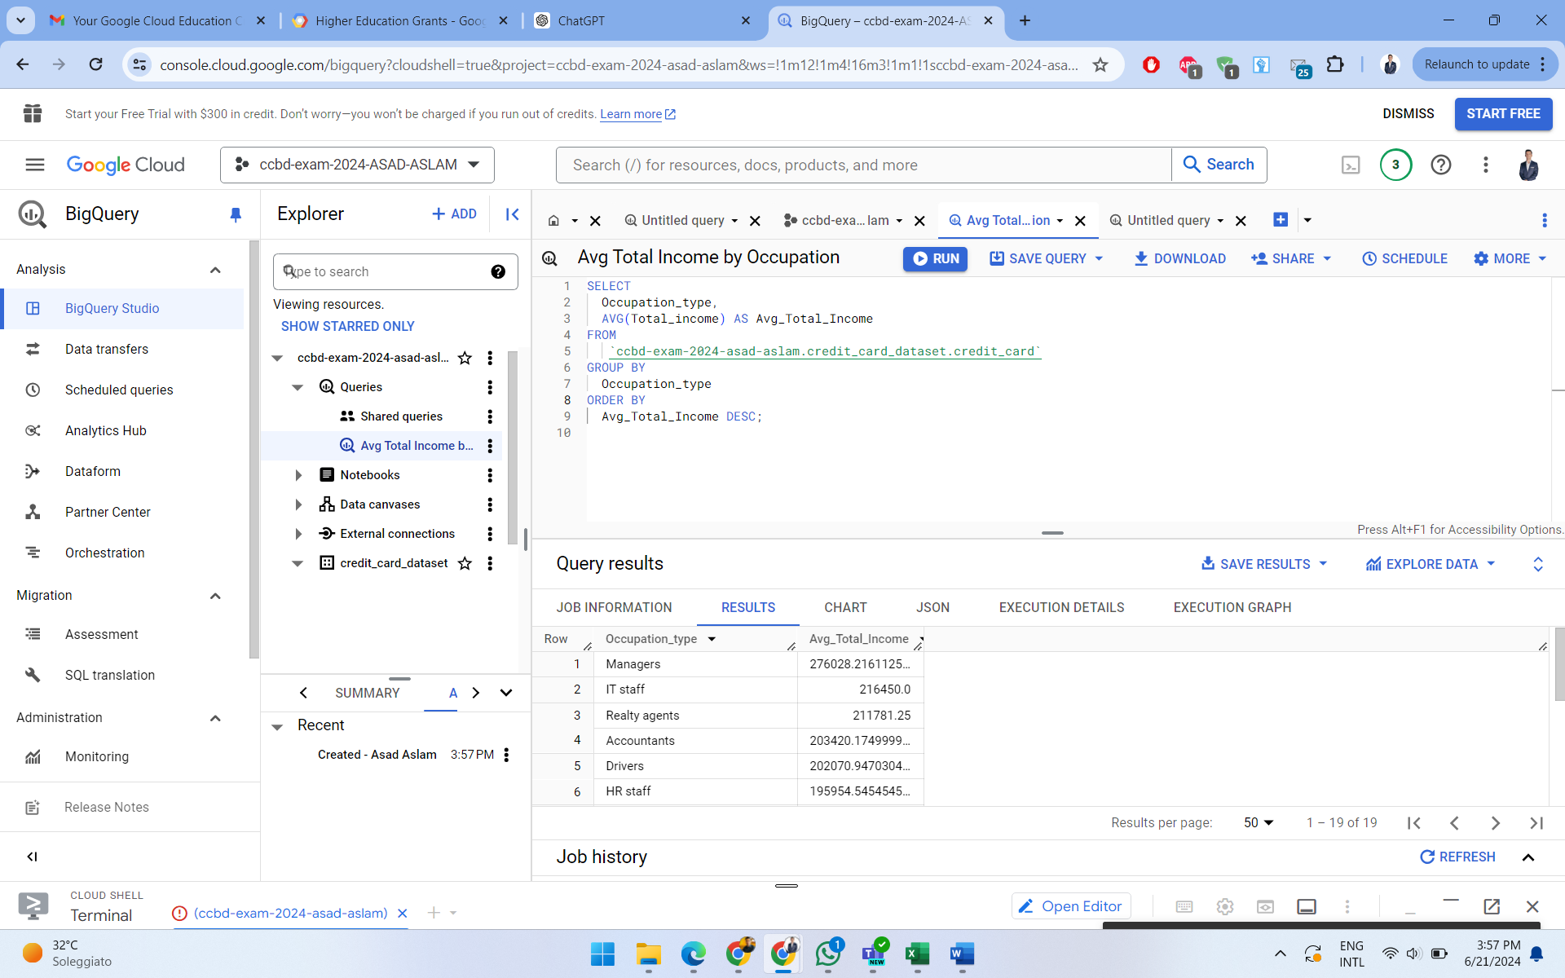
EXECUTING QUERIES ON BIG QUERY UI
What is the average Total_income for each Occupation_type?

Slide 20
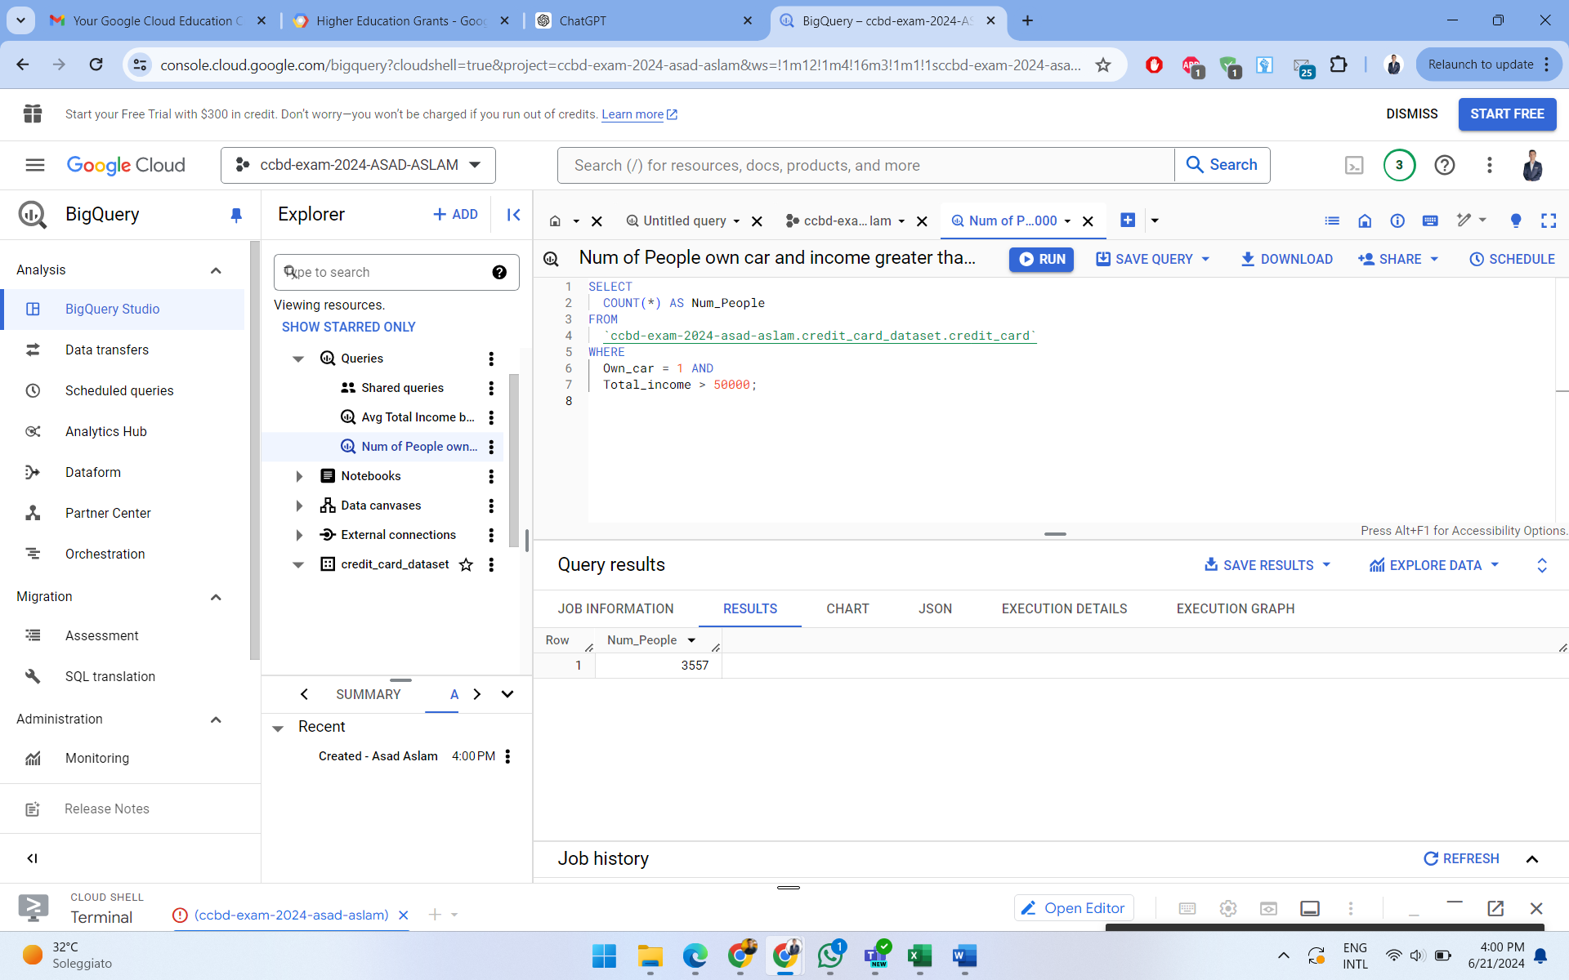
EXECUTING QUERIES ON BIG QUERY UI
2. How many people own a car and have an income greater than $50,000?

Slide 21
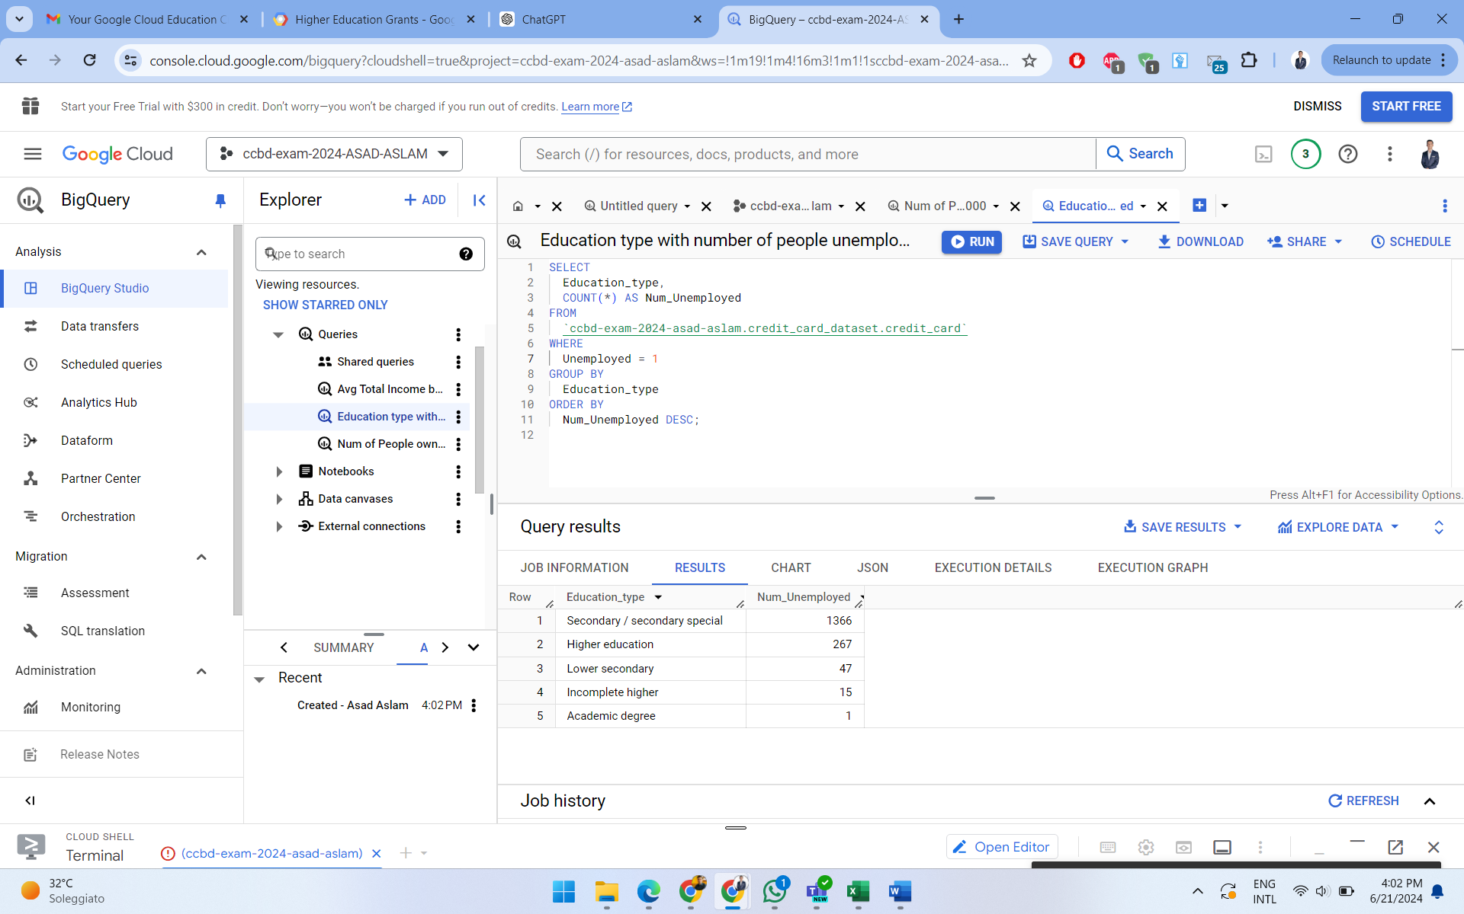
EXECUTING QUERIES ON BIG QUERY UI
3. What is the distribution of Education_type among people who are unemployed?

Slide 22
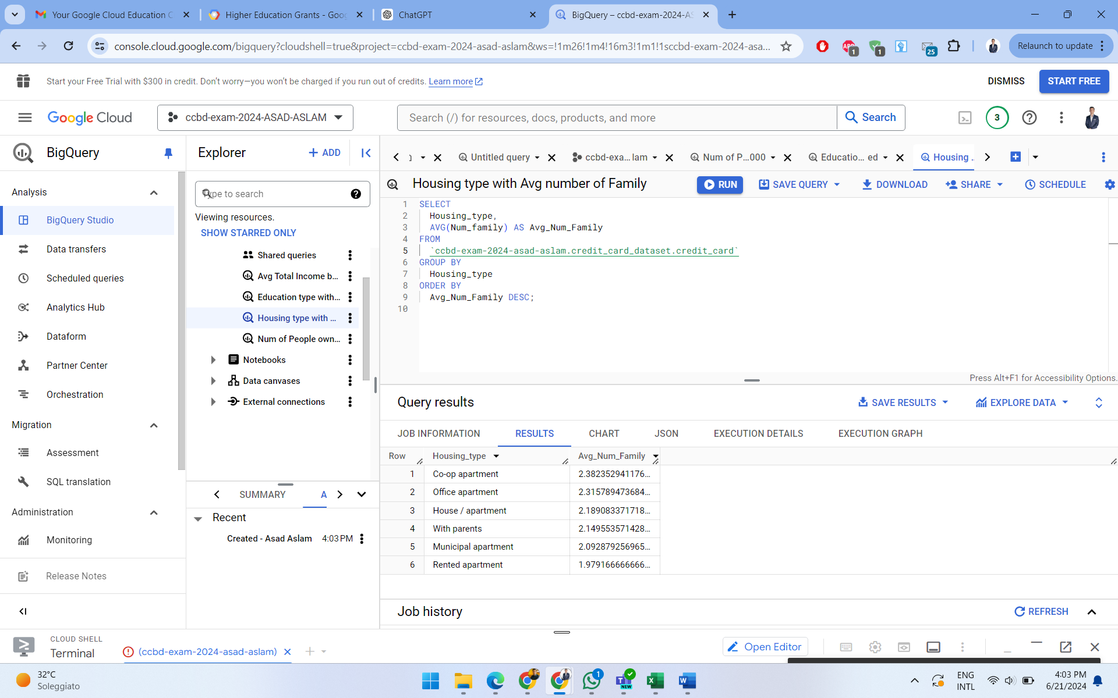
EXECUTING QUERIES ON BIG QUERY UI
4. What is the average number of Num_family members for different Housing_type categories?

Slide 23
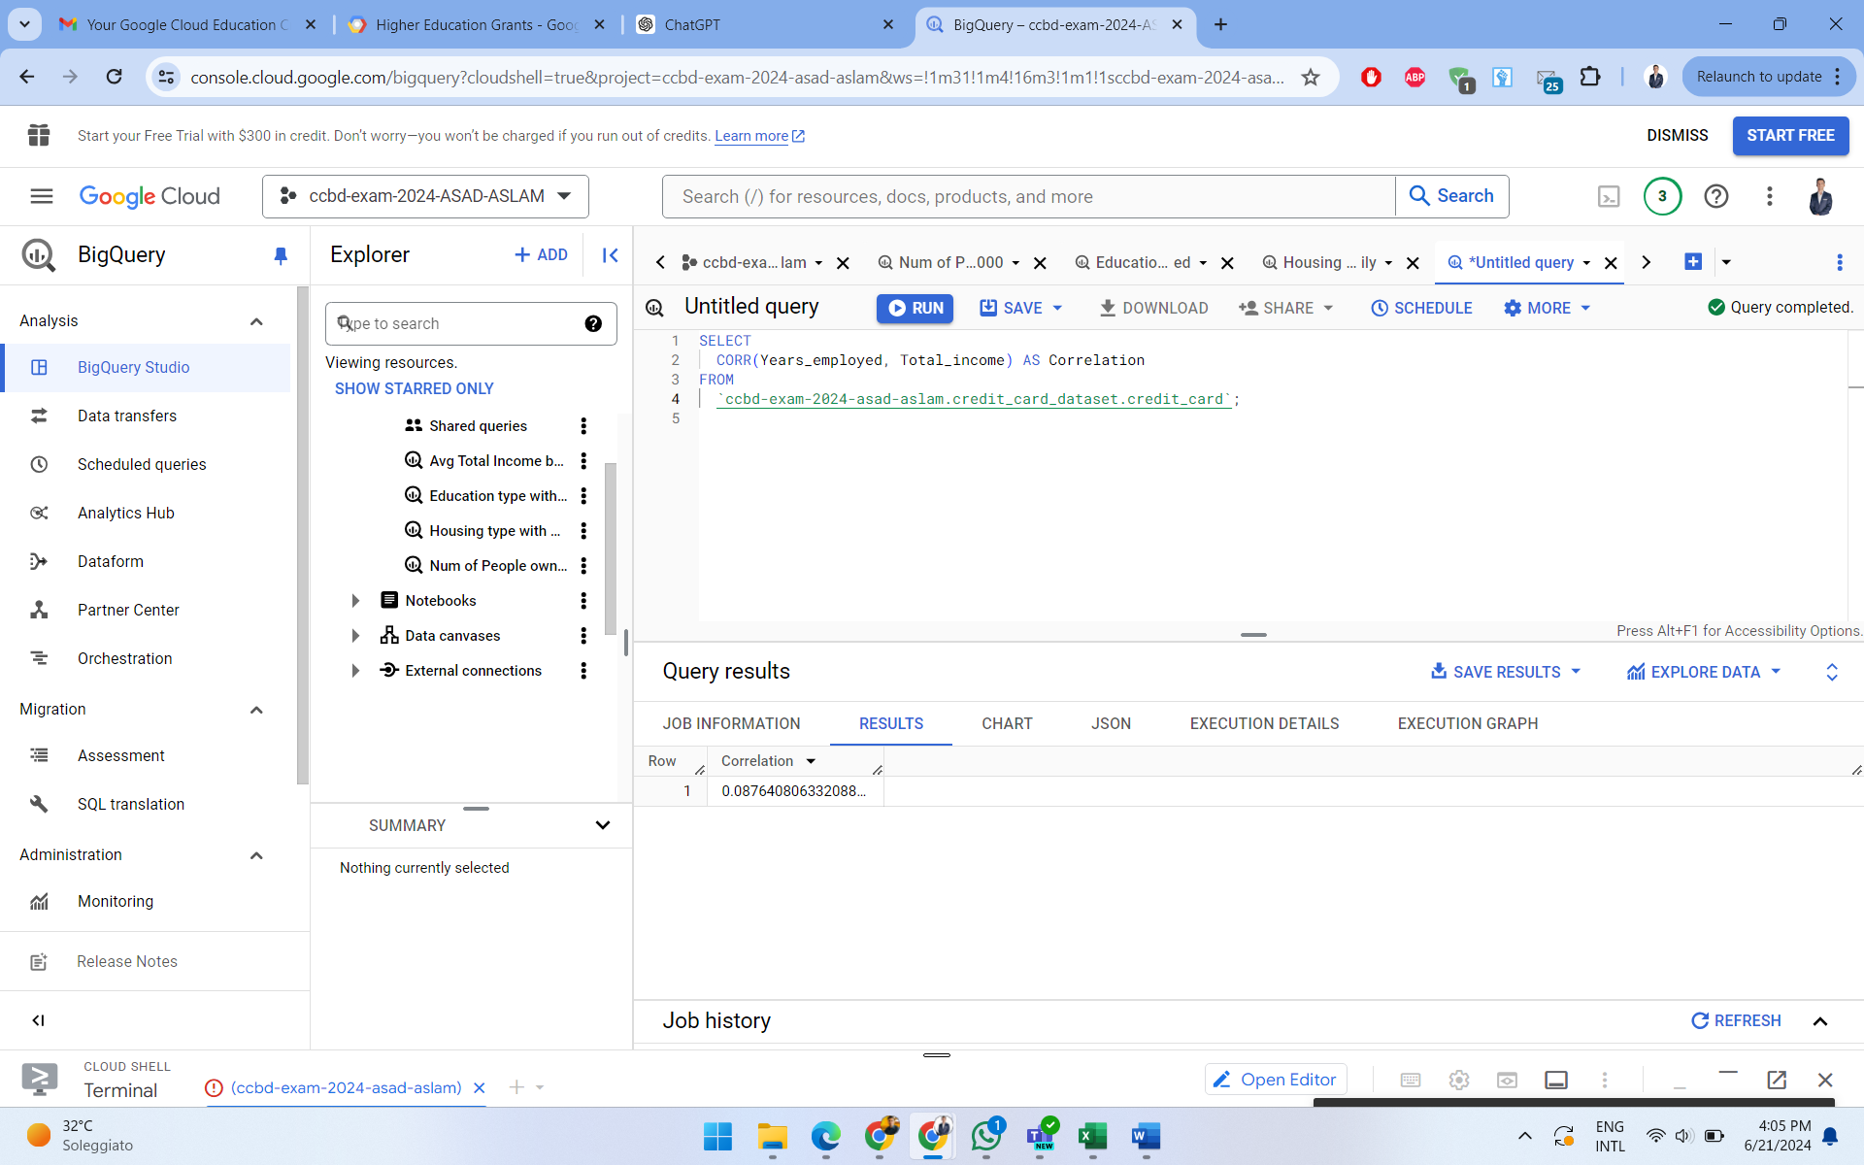
EXECUTING QUERIES ON BIG QUERY UI
5. What is the correlation between Years_employed and Total_income?

Slide 24
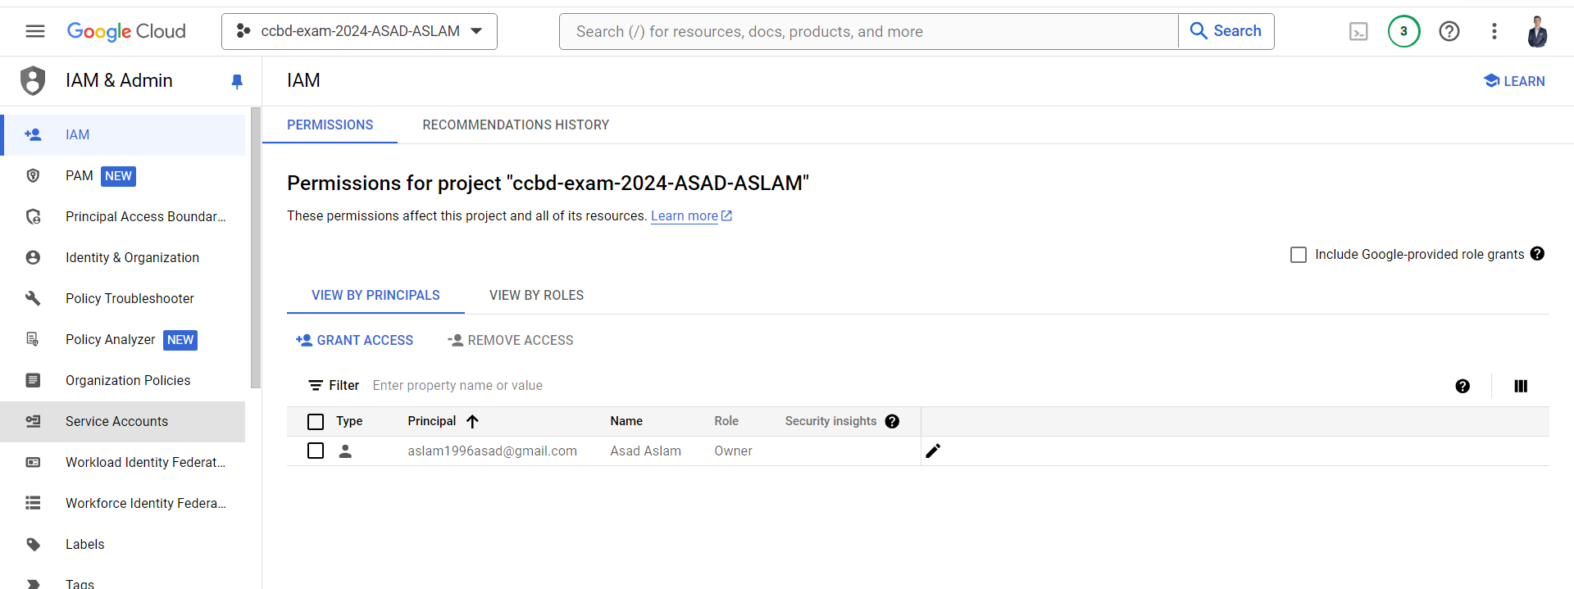
EXECUTING QUERIES ON JUPYTER NOTEBOOK: CREATING JSON KEY 1/3

Slide 25
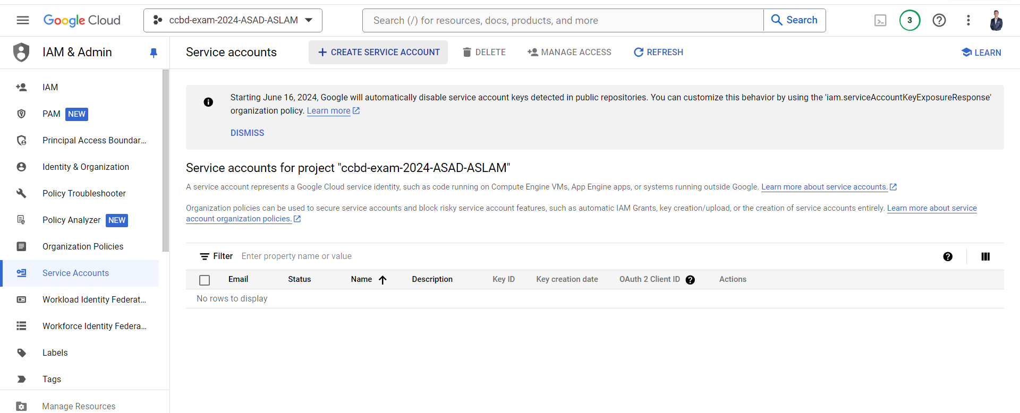
EXECUTING QUERIES ON JUPYTER NOTEBOOK: CREATING JSON KEY 2/3

Slide 26
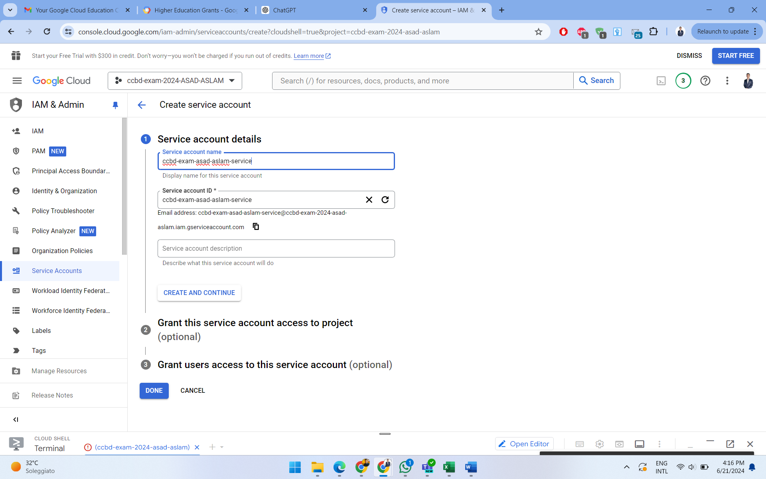
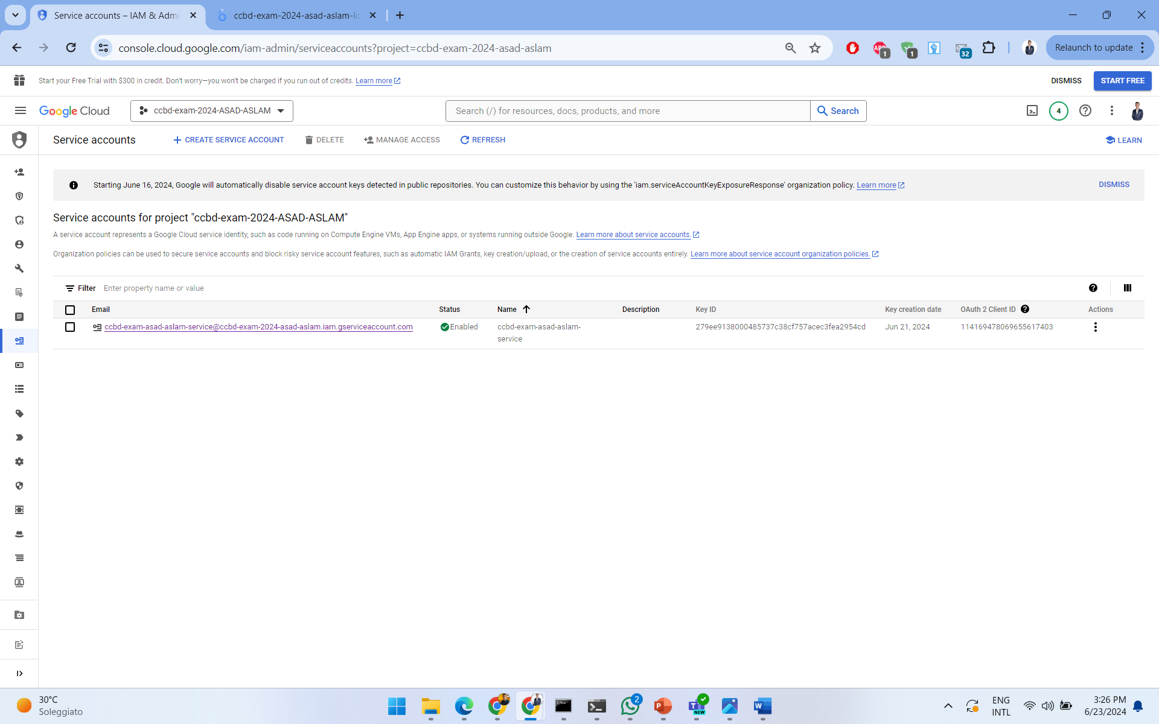
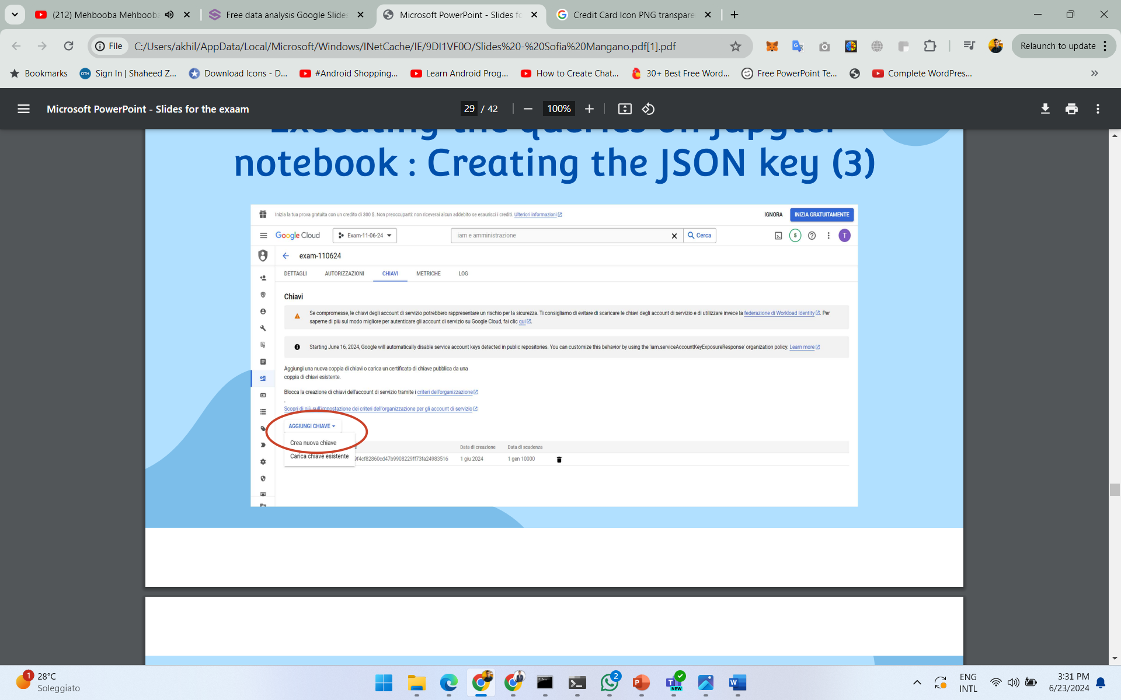
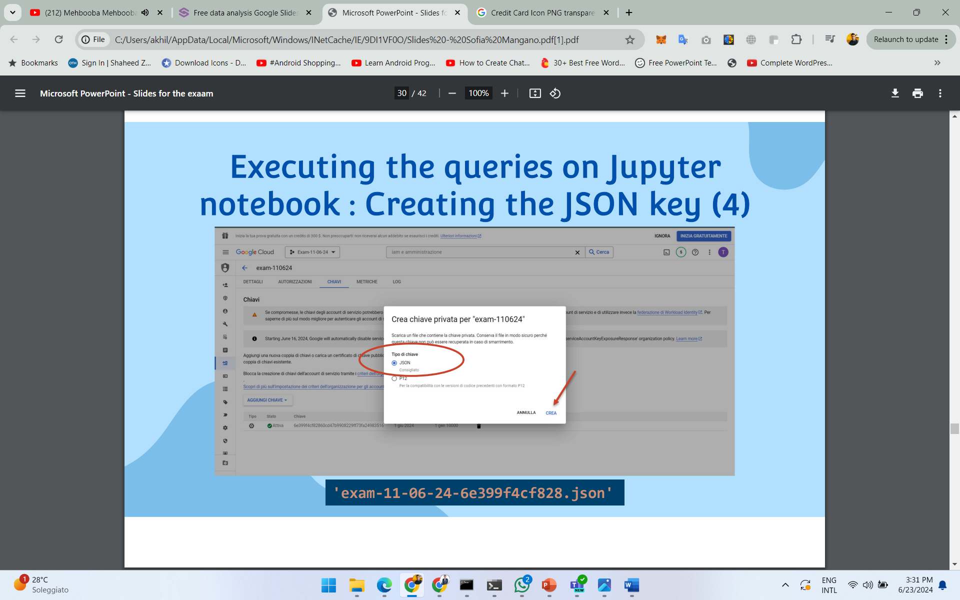
EXECUTING QUERIES ON JUPYTER NOTEBOOK: CREATING JSON KEY 3/3

Slide 27
EXECUTING QUERIES ON JUPYTER NOTEBOOK
ccbd-exam-2024-asad-aslam-jupyter.ipynb

Slide 28
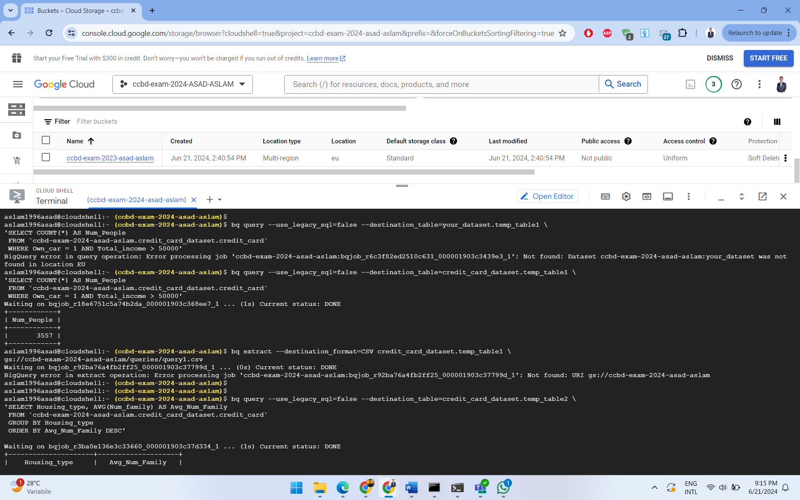
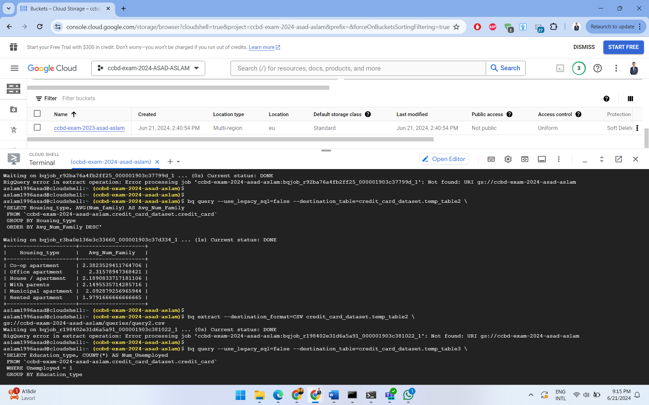
EXPORTING THE QUERIES INTO THE BUCKET 1/4

Slide 29
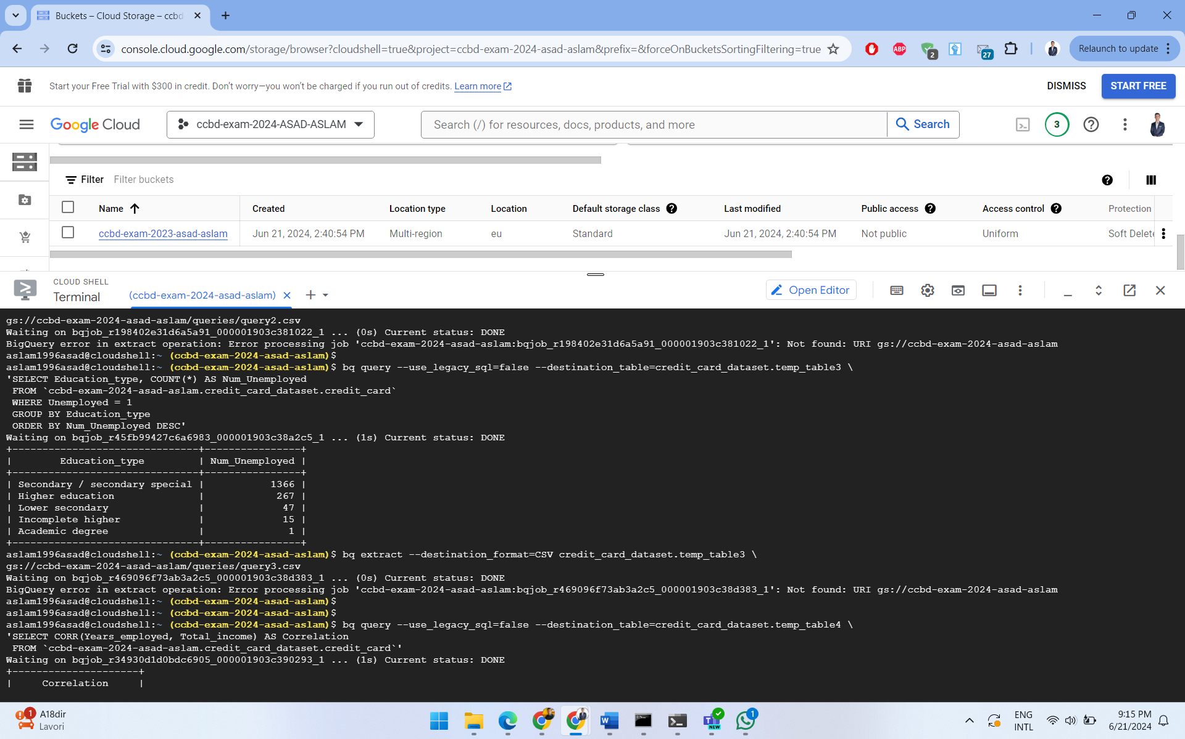
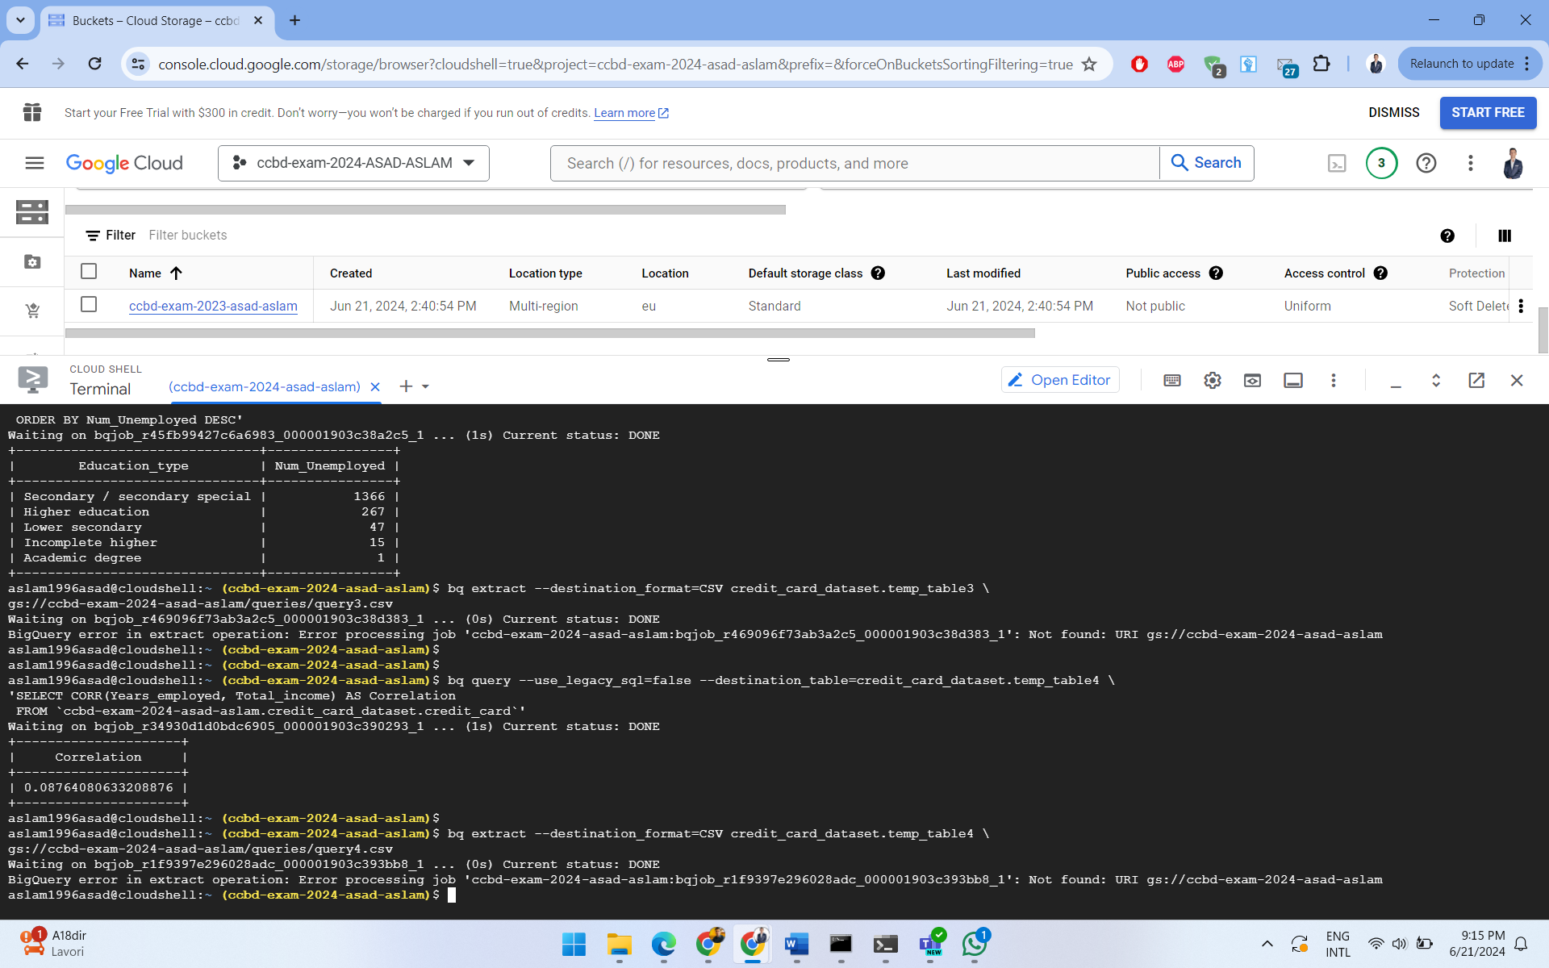
EXPORTING THE QUERIES INTO THE BUCKET 2/4

Slide 30
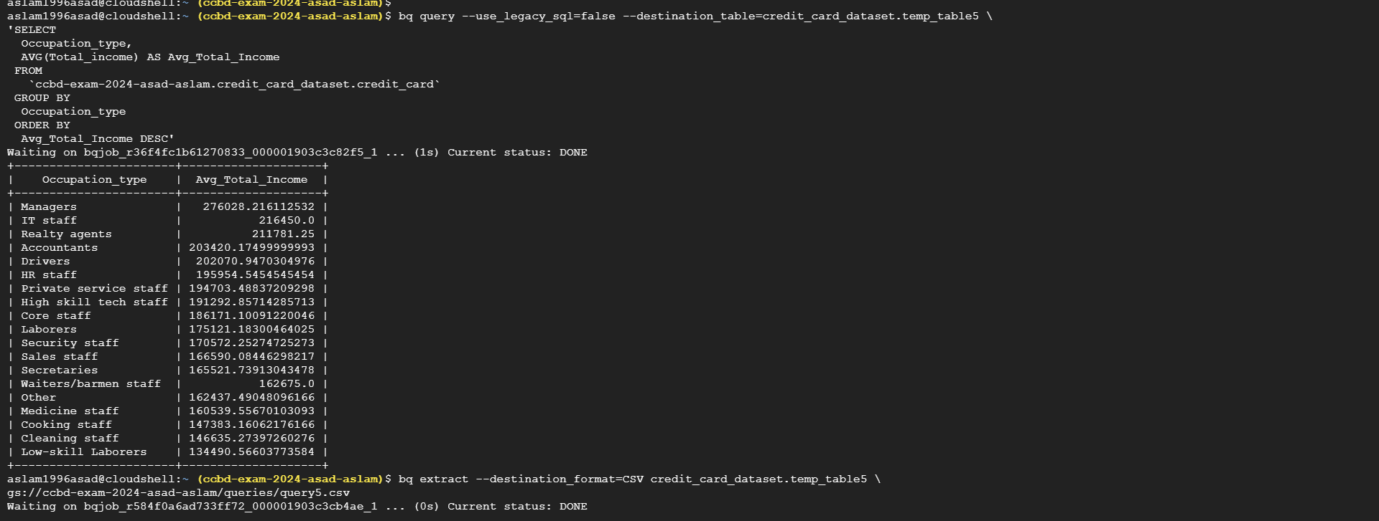
EXPORTING THE QUERIES INTO THE BUCKET 3/4

Slide 31
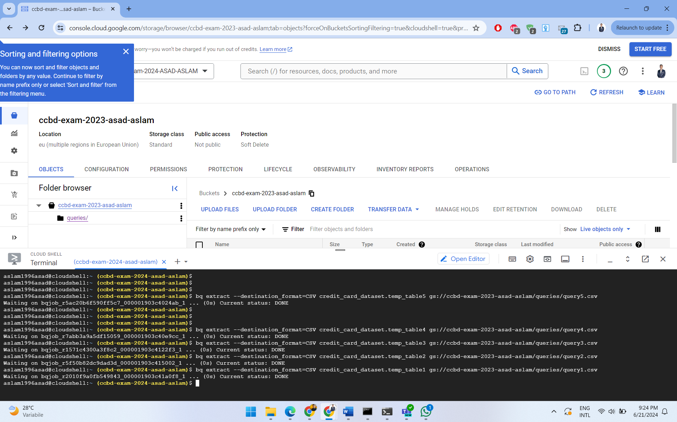
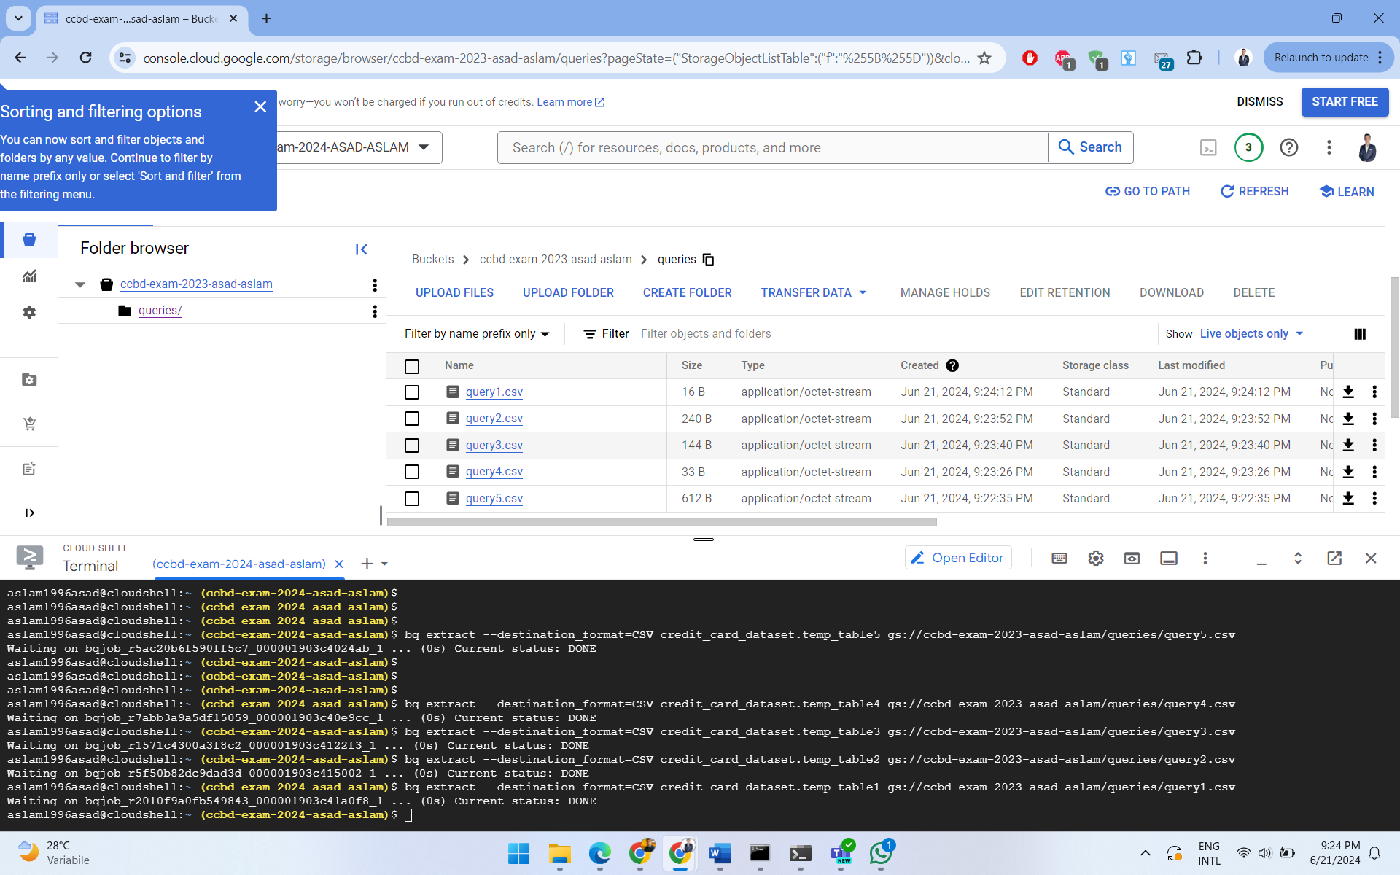
EXPORTING THE QUERIES INTO THE BUCKET 4/4

Slide 32
DATA ANALYSIS USING SPARK NOTEBOOKS

Slide 33
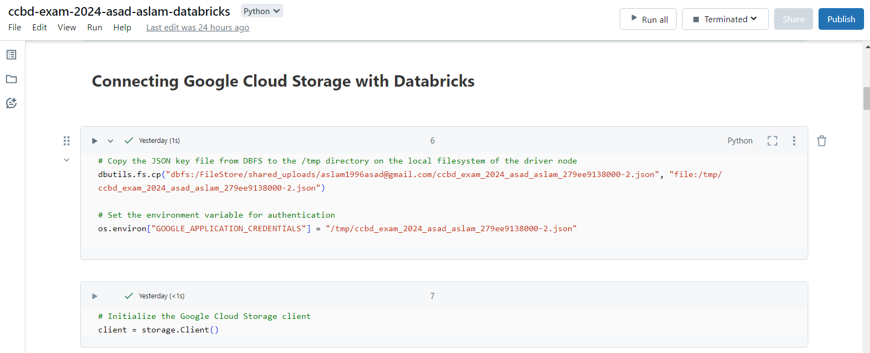
READING DATA FROM GOOGLE CLOUD STORAGE 1/2

Slide 34
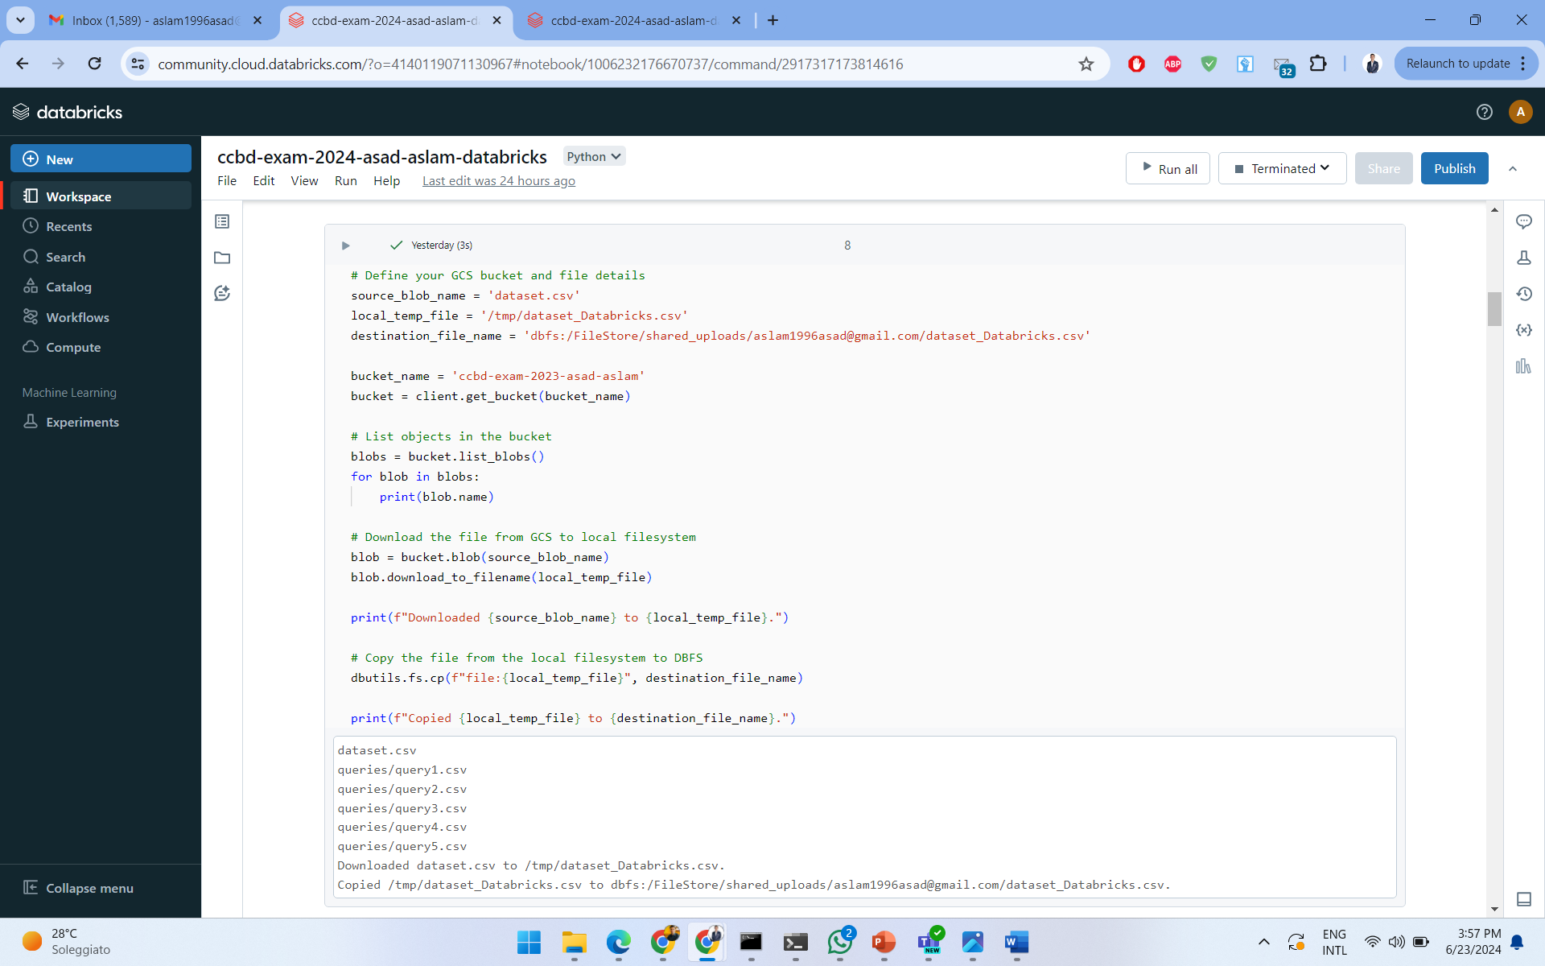
READING DATA FROM GOOGLE CLOUD STORAGE 2/2

Slide 35
EXECUTING QUERIES USING SPARK ON DATABRICKS
ccbd-exam-2024-asad-aslam-databricks

Slide 36
DATA ENRICHMENT

Slide 37
MACHINE LEARNING ALGORITHM USING SPARK ON DATABRICKS
ccbd-exam-2024-asad-aslam-databricks

Slide 38
DATA VISUALIZATION

Slide 39
DASHBOARD REPRESENTING THE DATASET & QUERIES ON DATABRICKS
ccbd-exam-2024-asad-aslam-databricks

Slide 40
DASHBOARD REPRESENTING THE DATASET ON GOOGLE LOOKER
ccbd-exam-2024-asad-aslam-looker

Slide 41

ASAD ASLAM
LM-DATA
1000053142
THANK YOU

